Slide 1
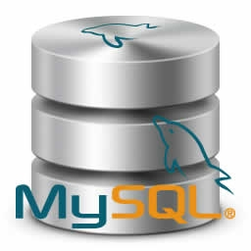
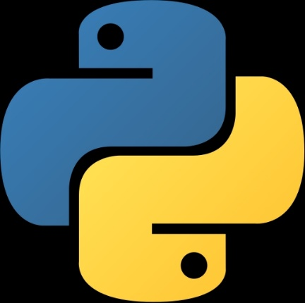
Python Database Connectivity

Slide 2
Agenda
Introduction to Python and MySQL
Need of MySQL Connector
How to install MySQL connector and Configuration using pip (python module installer)
Important methods to interact with MySQL database
Demo to execute simple query using python program

Slide 3

Easy to
Understand
Object Oriented
Portable
Dynamically
type
Free
Open
Source
Python Features

Slide 4
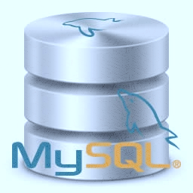
MySQL is freely available database system
One of the most popular DMS like Oracle ,Postgresql, etc.
It runs on multiple platforms such as Linux ,Windows
and Unix
MySQL store data in the form of tables/relations. Relation further store data in rows/tuples and column

Slide 5
Need of MySQL Connector
We can not directly communicate with database using python.
It is translator which accept the request from python application and convert request into database understandable format then it sends request to database.
Also it accept response from the database convert response to application understandable format and then sends back to application.

Slide 7
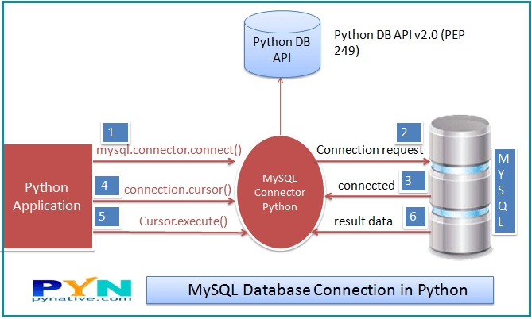

Slide 8
How to install MySQL driver/Module on cmd using pip command
check whether the pip is install in your system with python ( open cmd type command pip –v )
C:\Users\yoges>pip install mysql-connector
in cmd open python shell (python)
If following statement execute in python shell then our installation is finish
>>import mysql.connector

Slide 9
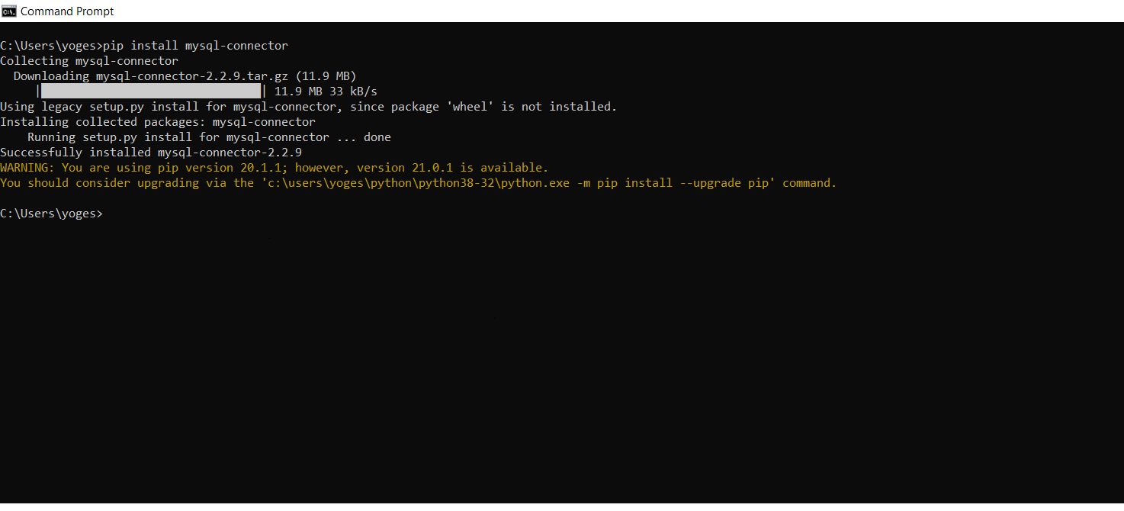

Slide 11
Basic MySQL connection Steps
Establish connection with MySQL database
Create cursor class object (cursor class objects are to execute SQL commands on database)
Access data and manipulate
Finally close the cursor and connection objects as:
cursor.close()
con.close()

Slide 12
Important methods
Method | Description
connect() | Used to establish connection with database mysql.connector.connection(host, user ,password , database_name)
cursor() | Returns cursor object using that we can execute SQL commands
execute() | It takes sql statement as argument Cursor_obj.execute(sql)
fetchone() | Used to access one row from table store in result object Result=cursor . fetchone()
fetchall() | Access multiple row
Cursor.close() | Closing the cursor
Conn.close() | Closing the connection object

Slide 13
Demo

Slide 14
Thanks………………

